Slide 1


UNIVERSITY OF TECHNOLOGY AND EDUCATION
FACULTY OF MECHANICAL ENGINEERING
GRADUATION PROJECT
Topic: DESIGN AND MANUFACTURE PICKLEBALL MACHINE
Instructor: TS. ĐỖ VĂN HIẾN
Performer: NGUYỄN QUANG GIAO MSSV: 19146121
BÙI TRƯƠNG VĨNH PHÚC MSSV: 20146518
Here is where your presentation begins
Ho Chi Minh, January 18, 2025

Slide 2
Project Presentation Content
I: Reasons for choosing the topic, purpose and requirements of the project
II: Design and manufacture hardware structures
III: Algorithm and Control
Business Report of Company Department Report of Company Department
IV: Experiment
V: Conclusion

Slide 3
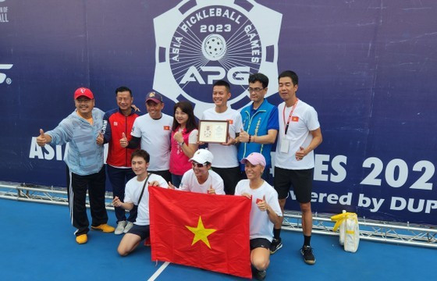
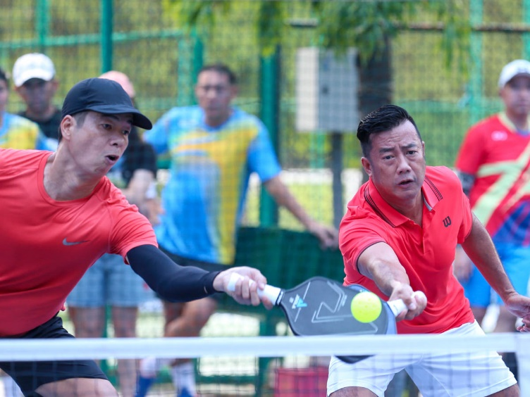
I: Reasons for choosing the topic, purpose and requirements of the project
CONTENTS
Reasons for choosing the topic
In Vietnam, Pickleball began to appear in 2018 and has quickly become popular. Many playgrounds and Pickleball clubs have been established in Hanoi, Ho Chi Minh City and other provinces.
With the continuous increase in players, the supporting equipment is still limited, including ball pickers.
With the desire to create a ball picker for players, we decided to design and manufacture a Pickleball picker machine.
a. Practical needs from pickleball players
b. The Urgency of Improving Training Efficiency
c. Applicability and commercial potential
d. Exploiting technology and technical innovation
e. Contribute to promoting community sports movement
f. Academic significance and personal skill development

Slide 4
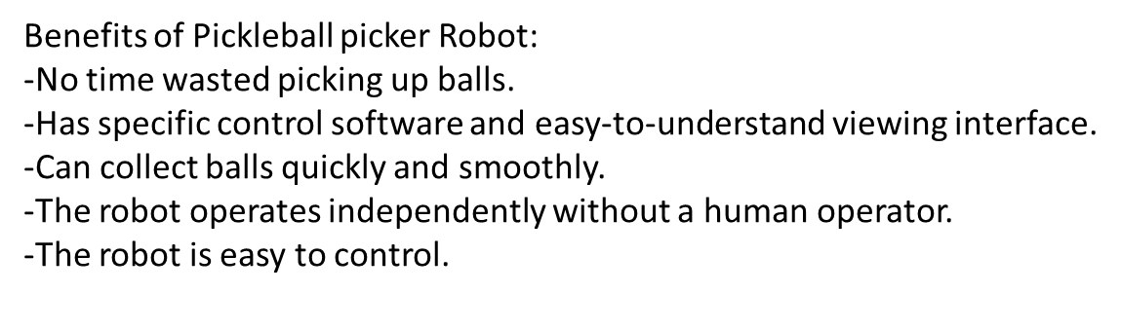
I: Reasons for choosing the topic, purpose and requirements of the project
Purpose of project
Requirements of the project
˗Limited working area: 40m2.
˗Operating conditions: Outdoors, no rain.
˗Operates on flat terrain.
˗Maximum robot operating time: 45 minutes.

Slide 5
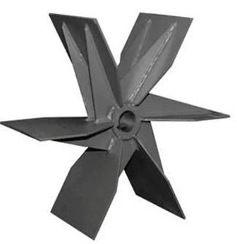
II: Design and manufacture hardware structures
CONTENTS
After considering the methods,
we decided to choose “Paddle Methods” to collect the ball.
-With strong rotation force, when the pickleball to
touch the fan blade to easily collect the pickleball inside.
-The structure of the paddle wheel is
relatively simple, easy to manufacture,
maintain and can change the size of the
fan blade depending on the size of the ball easily.
Paddle wheel

Slide 6
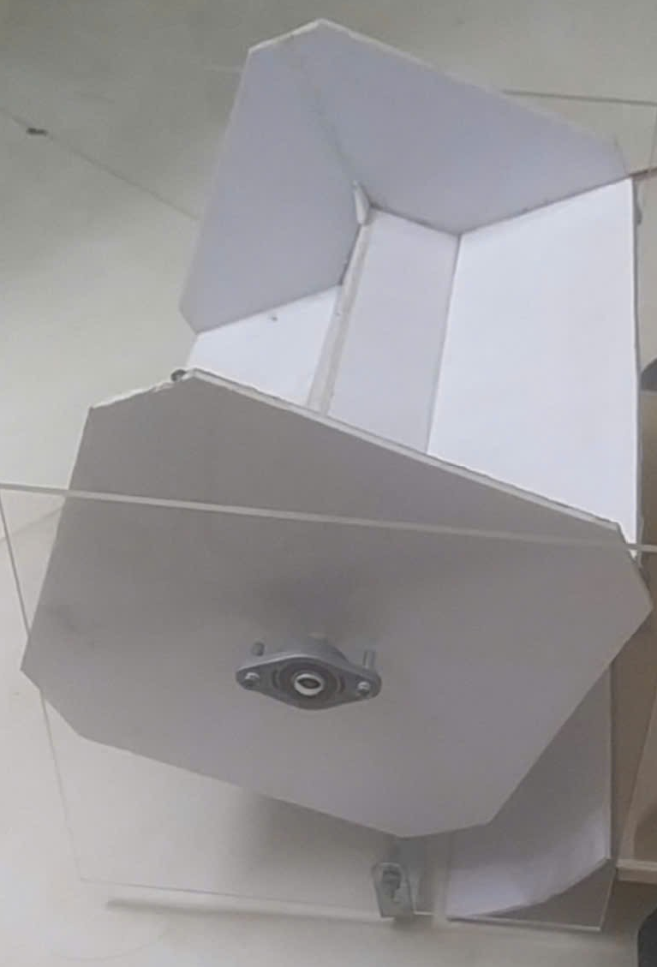
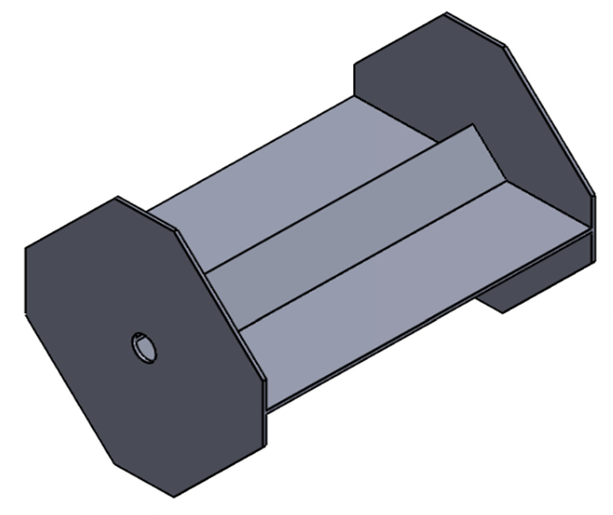
II: Design and manufacture hardware structures
CONTENTS
Design and manufacture Ball collection mechanism
Design in software
Actual construction

Slide 7
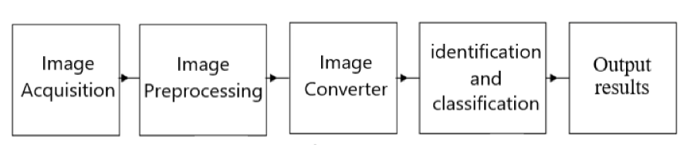
II: Design and manufacture hardware structures
CONTENTS
Image processing
Image processing is the process of converting images into digital form and performing operations to extract useful information from that image.

Slide 8
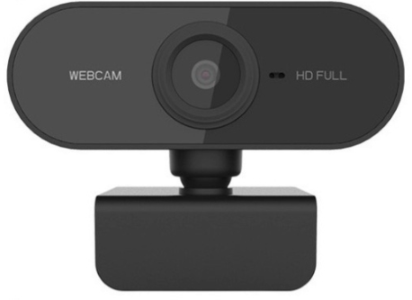
II: Design and manufacture hardware structures
CONTENTS
Image processing
Step 1: Image acquisition
Webcam HD 1080p
Dimensions: 79mm x 31mm x 38.5mm.
Video resolution: 1080p.
Photo resolution: 10MP.
Frame rate: 60FPS.
Color: Black - Resolution: HD 1080
Connection: USB 2.0
Cable length: 1.5m
Webcam HD 1080p

Slide 9
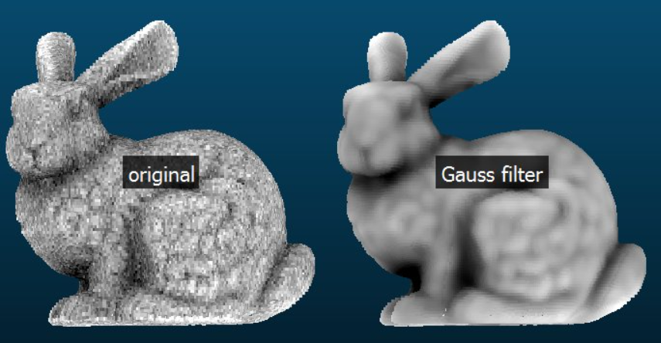
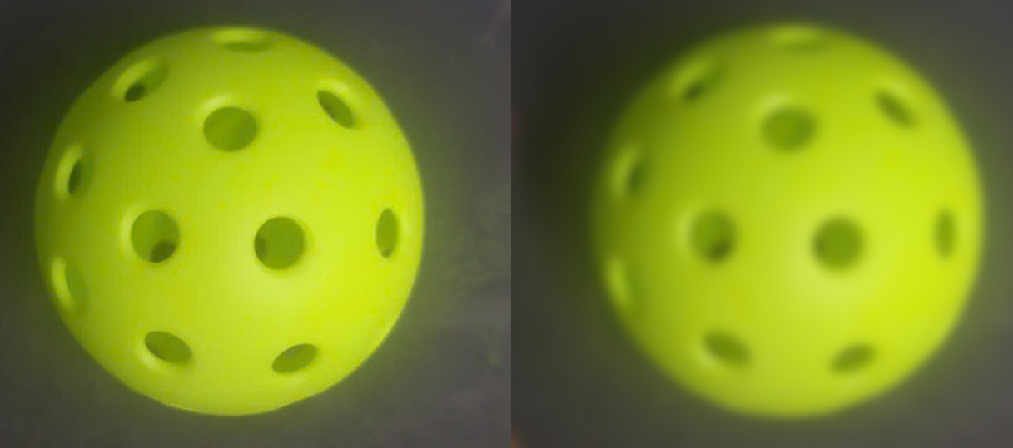
II: Design and manufacture hardware structures
CONTENTS
Image processing
Step 2: Image processing
Before and after using Gaussian filter
Result with pickleball

Slide 10
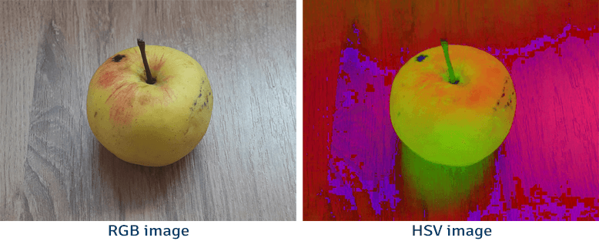
II: Design and manufacture hardware structures
CONTENTS
Image processing
Step 3: Image converter
Convert the RGB color space to HSV color space

Slide 11
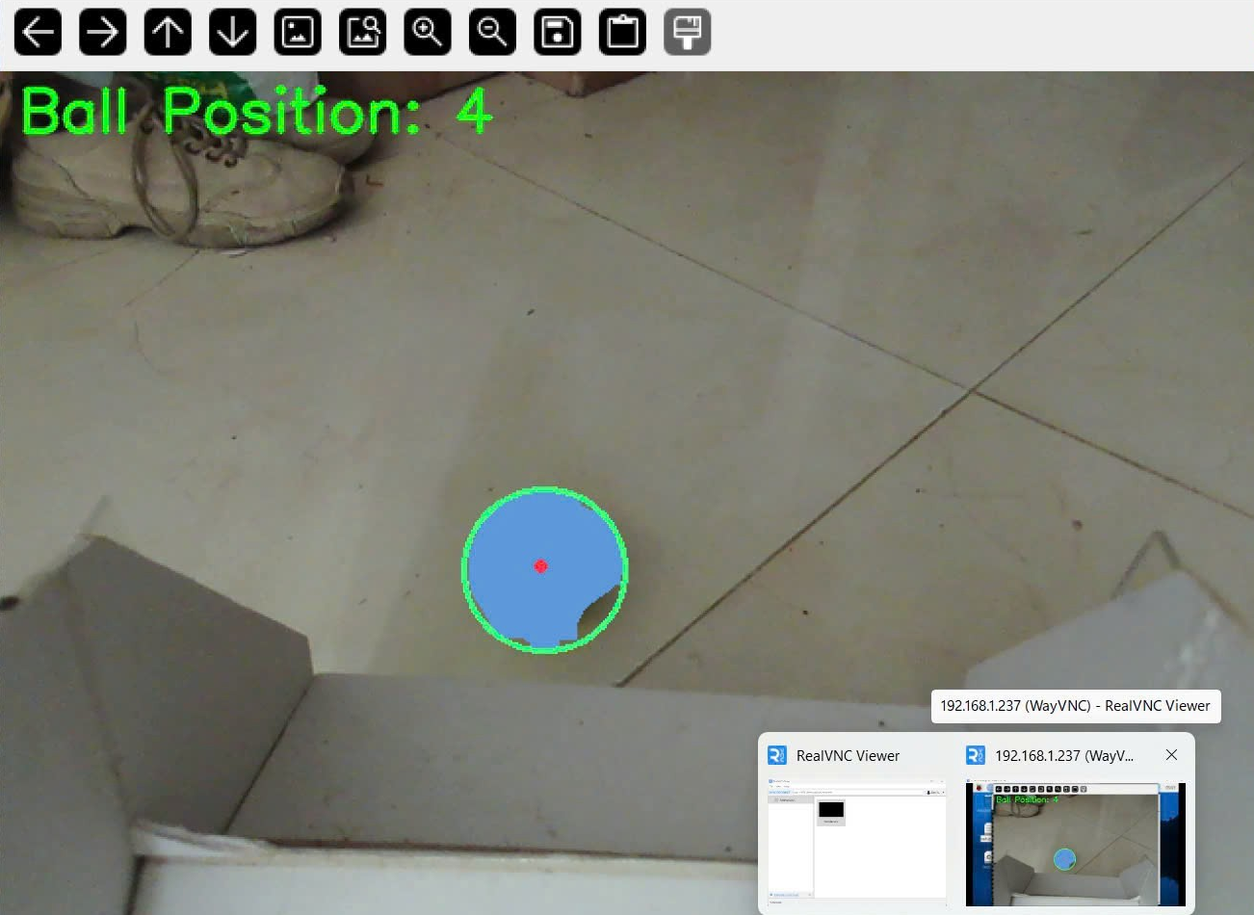
II: Design and manufacture hardware structures
Image processing
Step 4: Identification and classification
Canny edge detection
Good noise immunity
Minimal error
-Use Hough Transform and
Color Segmentation
- Determine the position of the ball
Output Results

Slide 12
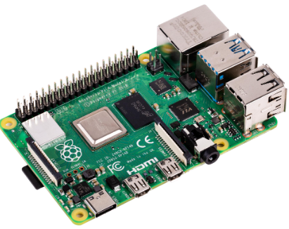
II: Design and manufacture hardware structures
CONTENTS
Raspberry Pi is a small-sized computer (SBC - Single Board Computer)
Easy Access: With its affordable price, Raspberry Pi allows
everyone, especially students and beginners, to have access
to microcontroller technology and embedded computers.
Many applications such as:
-Build Projects IoT (Internet of Things)
-Control Small Robots
-Home Automation
-Web Servers
Raspberry Pi 4 Model B 8gb
Convenience: Raspberry Pi is compact in size, easy to
carry and use anywhere.

Slide 13
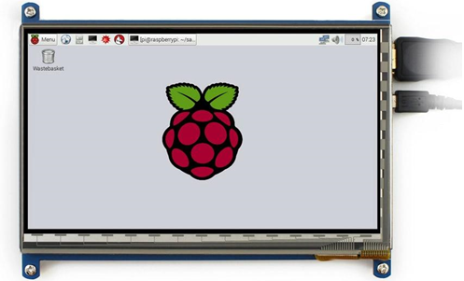
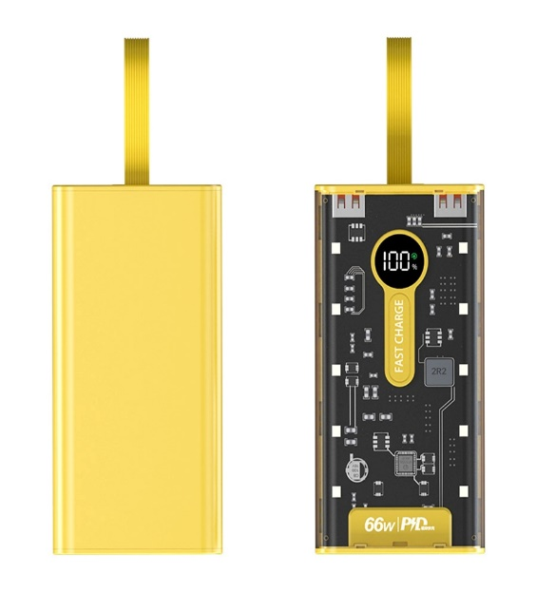
II: Design and manufacture hardware structures
CONTENTS
7inch HDMI LCD touch screen allows Raspberry Pi to be connected via HDMI port, 800×480 resolution capacitive touch, supports Raspberry Pi and can also be used as a computer monitor. In this project, Waveshare screen will be connected to Raspberry Pi to display the image of the environment in front of the camera when detecting for the purpose of processing Pickleball image.
Waveshare 7inch LCD
Similar to previous products, 120W 20000mAh power bank is equipped with Li-Po (Lithium Polymer) battery core from leading manufacturers such as LG/Panasonic.
Datasheet:
- Slim and lightweight design
- Battery capacity: 20.000 mAh
- Fast charging speed with a capacity of 18 W
- Includes 2 Micro USB and Type C input ports
- Equipped with 2 convenient USB output ports that can charge 2 devices at the same time.
120W Power Bank

Slide 14
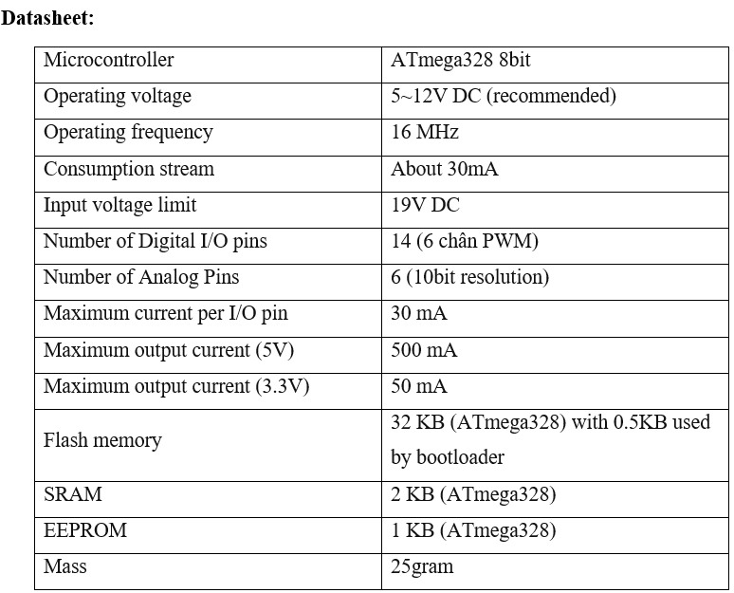
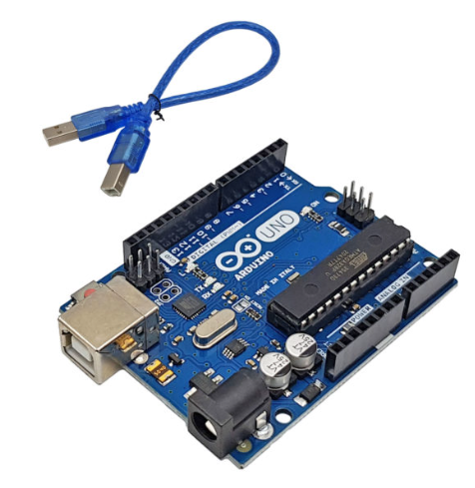
II: Design and manufacture hardware structures
CONTENTS
Choose MCU
Arduino Uno R3 is one of the most popular boards in the Arduino product line, widely used in electronics projects and embedded programming
Arduino Uno R3
Datasheet of Arduino Uno R3

Slide 15
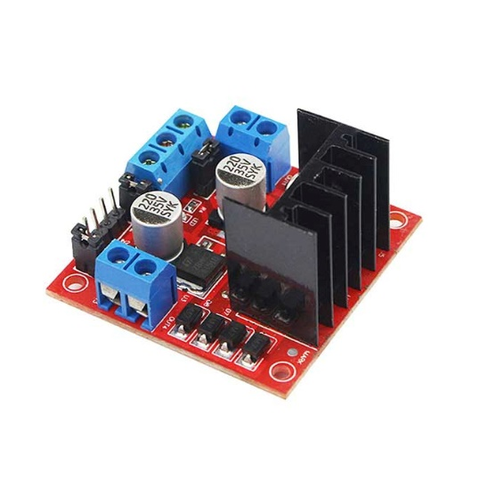
II: Design and manufacture hardware structures
CONTENTS
Motor control
The L298N DC motor control module can control two DC motors, the maximum current is 2A per motor, this module includes a protection diode and a 7805 power IC to supply 5VDC to other modules (use this 5V only if the power supply is <12VDC). This circuit is simple and easy to use, has a low price and is the best choice in the price range.
Datasheet
-Main IC is L298 – Dual Full Bridge Driver.
-Input voltage from 5 to 30VDC.
-Maximum power is 25W for each bridge (note that power is calculated by current multiplied by voltage, so when the input voltage is higher, the current is smaller, the power remains the same at 25W).
-Maximum current for each H-bridge is 2A.
-Logic voltage levels: Low from -0.3V to 1.5V, High from 2.3V to Vss (ground).
-The size of the circuit is 43x43x27mm.
L298N

Slide 16
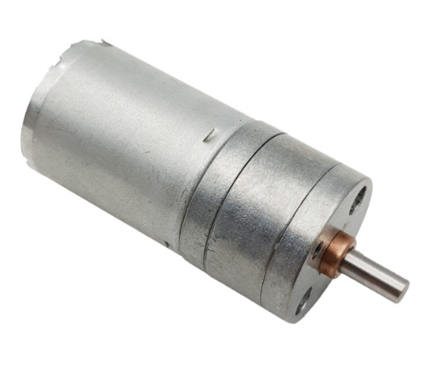
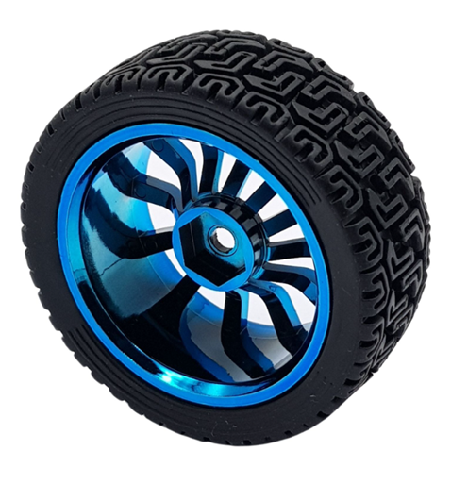
II: Design and manufacture hardware structures
CONTENTS
Select motor
We chose motor JGA25 130RPM for the ball picker project.
Datasheet:
-Supply voltage: 6-18VDC
-Speed after gearbox: 130rpm
-Torque: 5 kg.cm = 0.49 N.m
-No-load current: 50mA
The JGA25-370 motor is a popular choice for applications requiring high torque at low speeds. Great for robot car model projects
Motor JGA25 130RPM
Select wheel
Choose Wheel Hex Joint 68mm– Type 3 for this project.
The wheel uses a common hexagon joint (12mm) which is easy to assemble and apply to the design.
Datasheet:
-Material: Hard plastic, foam padding, good rubber.
-Diameter: 68mm.
-Wheel width: 27mm
Wheel Hex Joint 68mm– Type 3

Slide 17
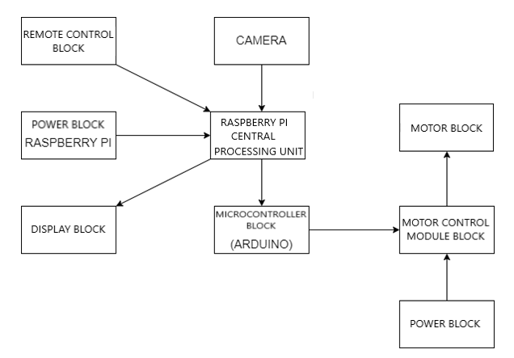
III: Design and Construction
CONTENTS
Block diagram of the system

Slide 18
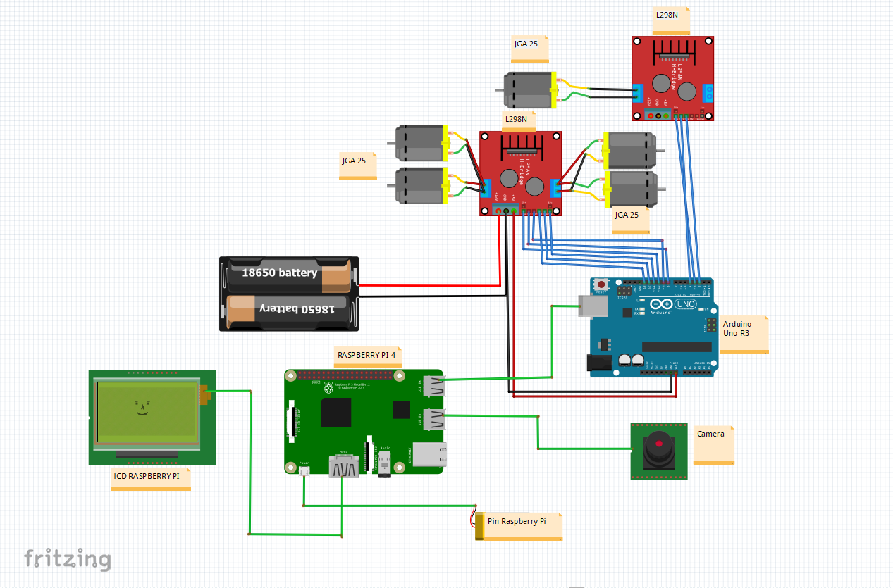
III: Design and Construction
CONTENTS
System wiring diagram

Slide 19
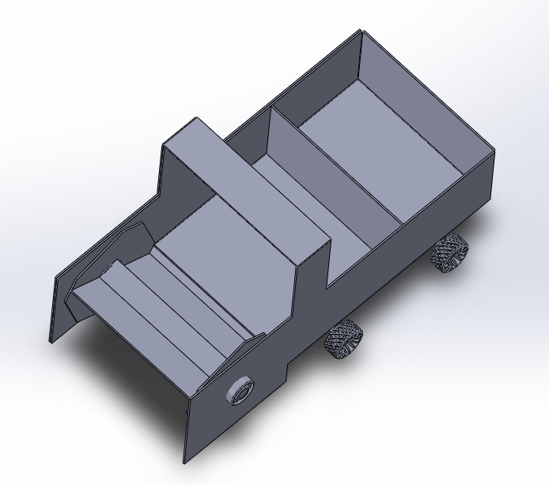
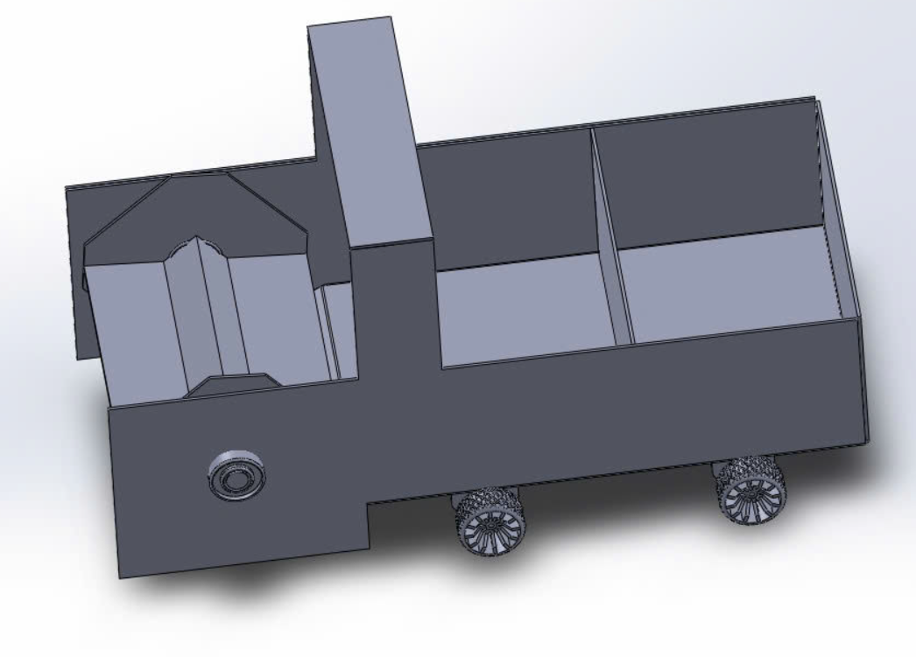
III: Design and Construction
CONTENTS
Robot design on software
Overall Robot Drawing
Robot drawing top view

Slide 20
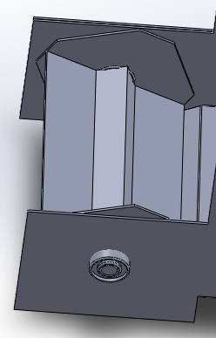
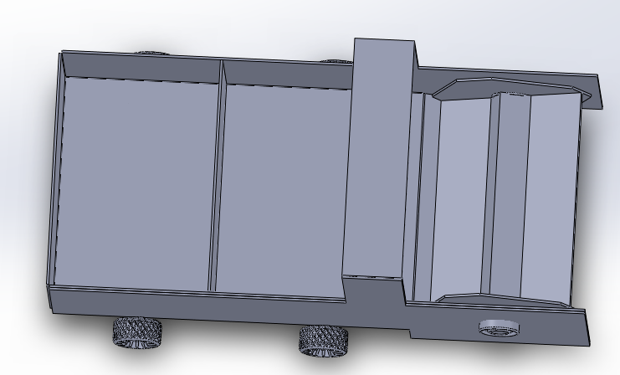
III: Design and Construction
CONTENTS
Robot design on software
Ball collection mechanism
Ball and accessory storage bin

Slide 21
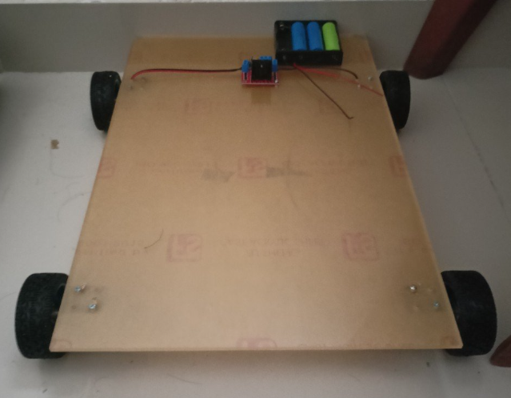
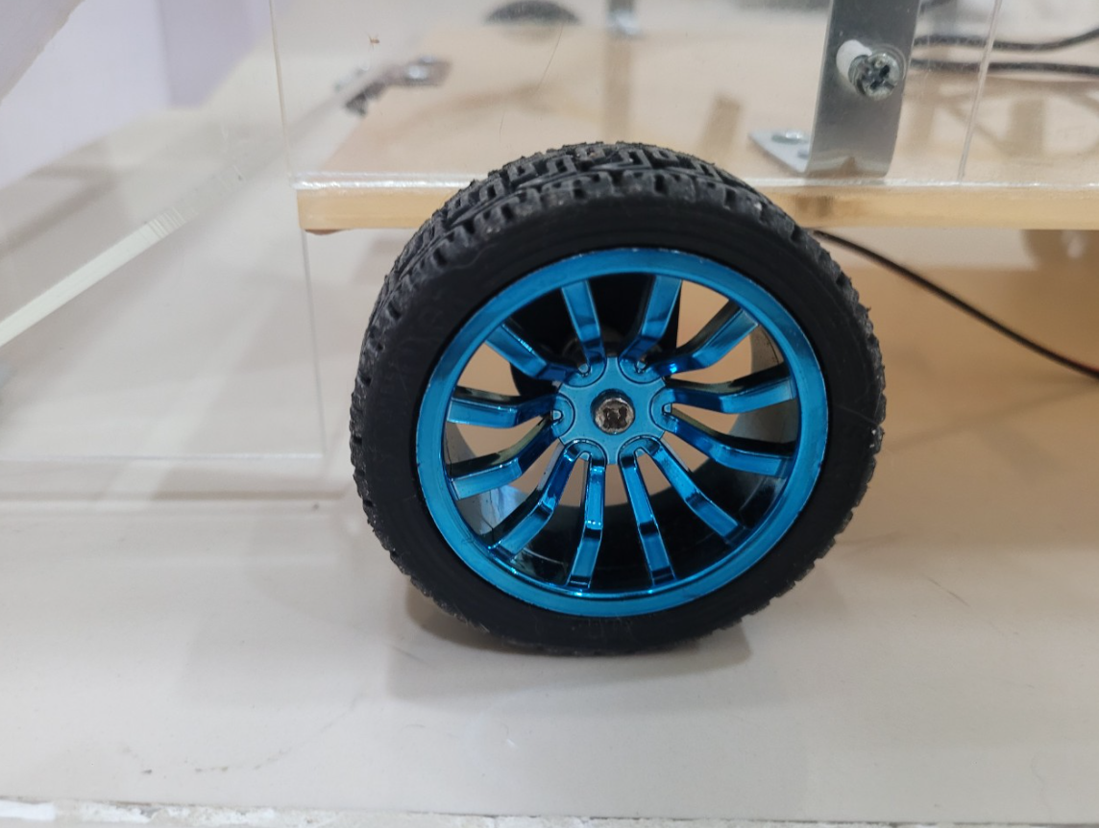
III: Design and Construction
CONTENTS
Construction
Step 1: Choose materials for the robot in the topic we will use mica because it is easy to buy, not too heavy.
Step 2: Choose the size of the robot to proceed to cut mica and assemble according to the desired size: Robot frame has a size of 30x45cm.
Robot frame
Step 3: Install the wheels, mount the motor to the
4 motors to make 4 wheels for the robot to move.
Robot wheel

Slide 22
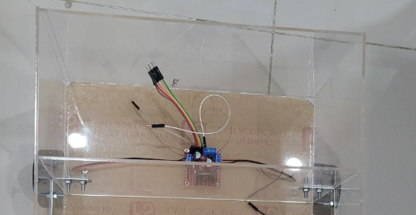
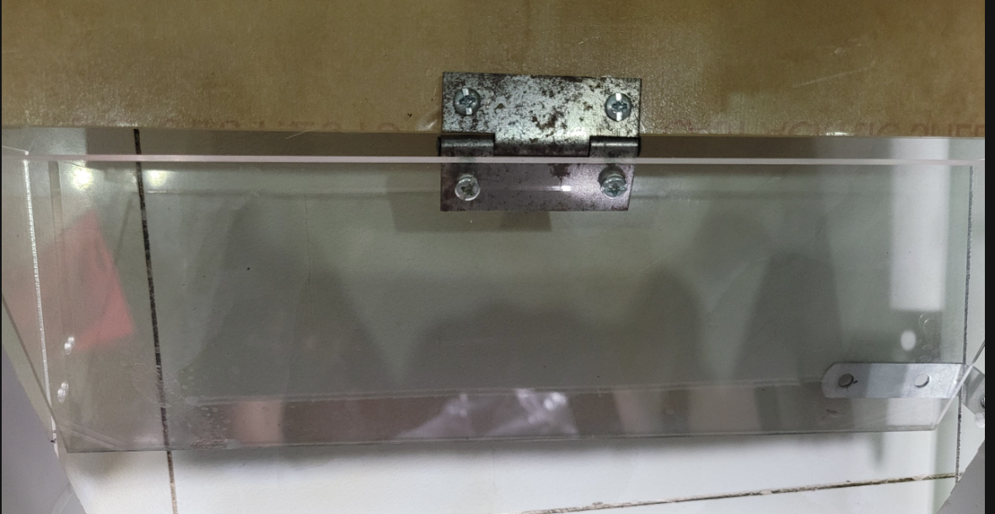
III: Design and Construction
CONTENTS
Construction
Step 4: Install the component compartment for the robot, this will hold all the components of the system
Component compartment
Step 5: Install a ramp to help roll the ball in for retrieval.
Ramp

Slide 23
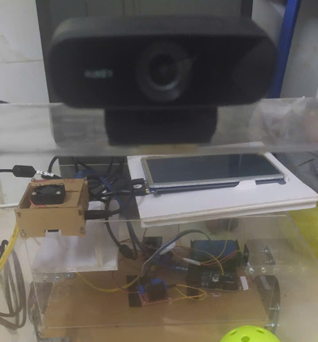
III: Design and Construction
CONTENTS
Construction
Step 6: Install the camera mount for the robot
The camera will be installed at the highest part
of the robot to have the widest viewing angle,
easily finding and identifying the pickleball.

Slide 24
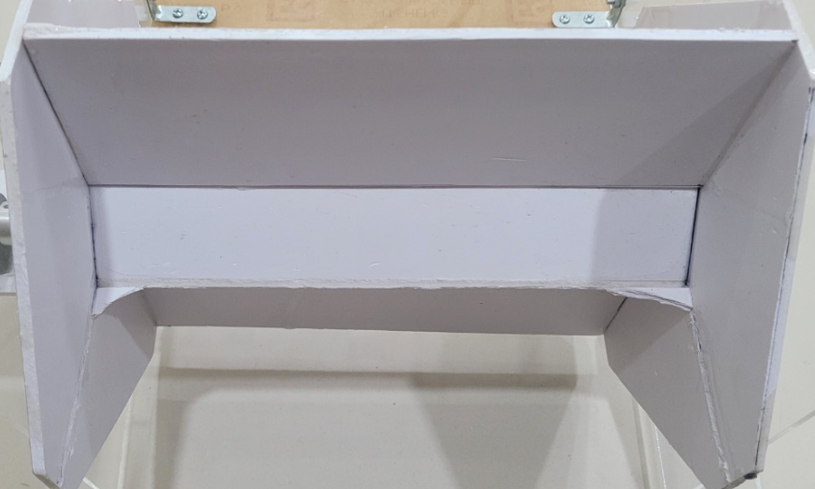
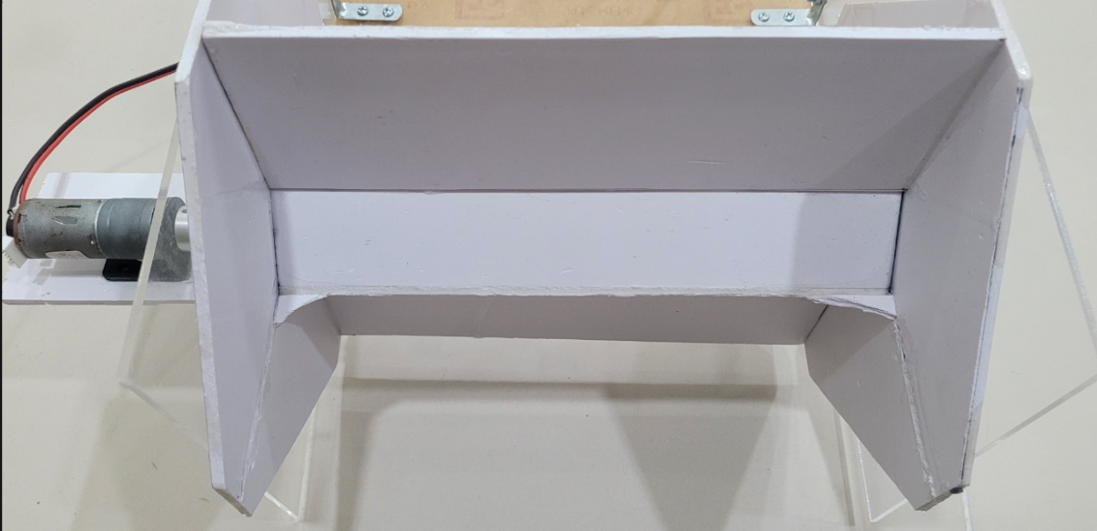
III: Design and Construction
CONTENTS
Construction
Step 7: Cut and paste the pickleball collecting mechanism for the robot
Pickleball chute
Step 8: Attach the horizontal shaft to the ball
collecting motor
Horizontal shaft mounting of ball collecting motor

Slide 25
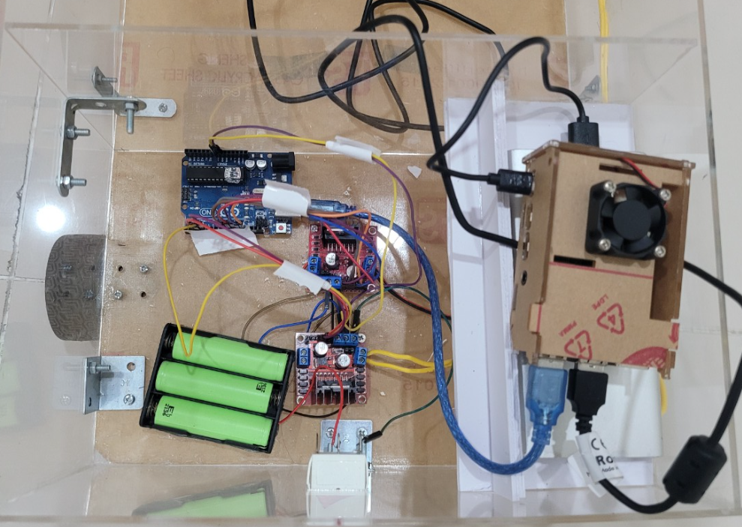
III: Design and Construction
CONTENTS
Construction
Step 9: Connect the wires as designed
Connect the wires according to the diagram

Slide 26
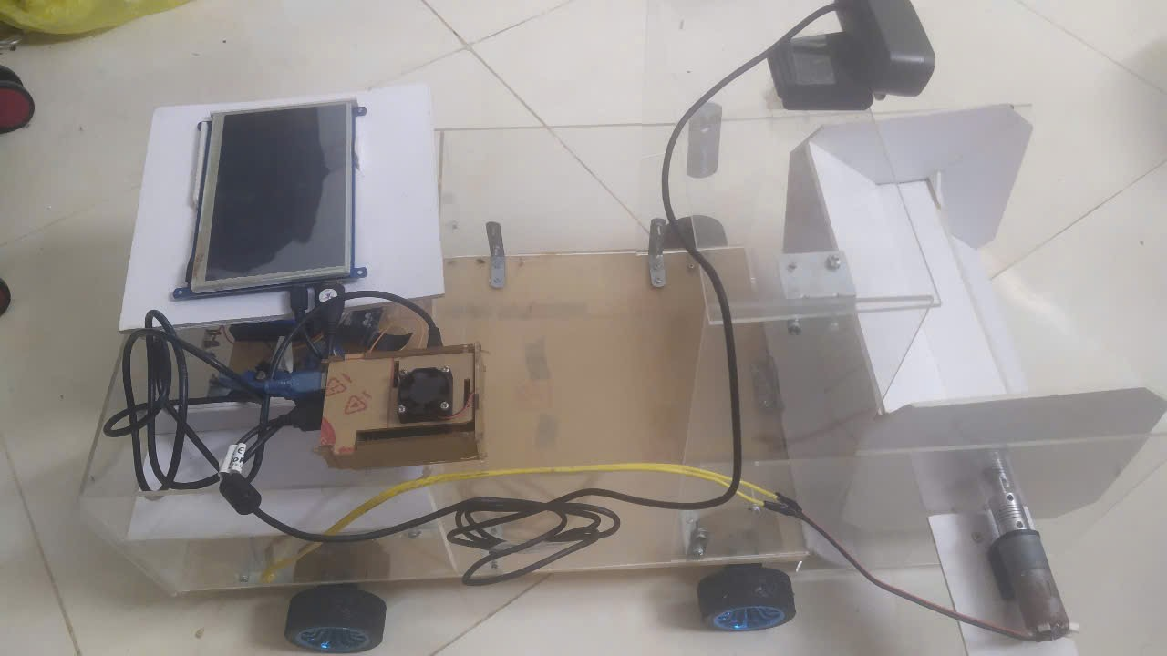
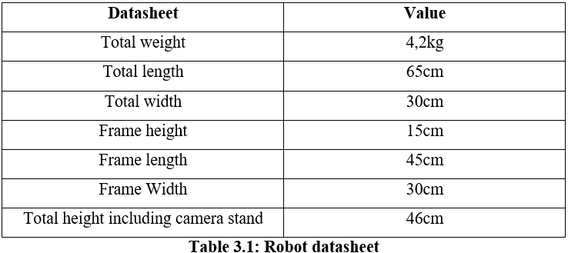
III: Design and Construction
CONTENTS
Construction
Step 10: Complete the overall robot
Robot complete

Slide 27
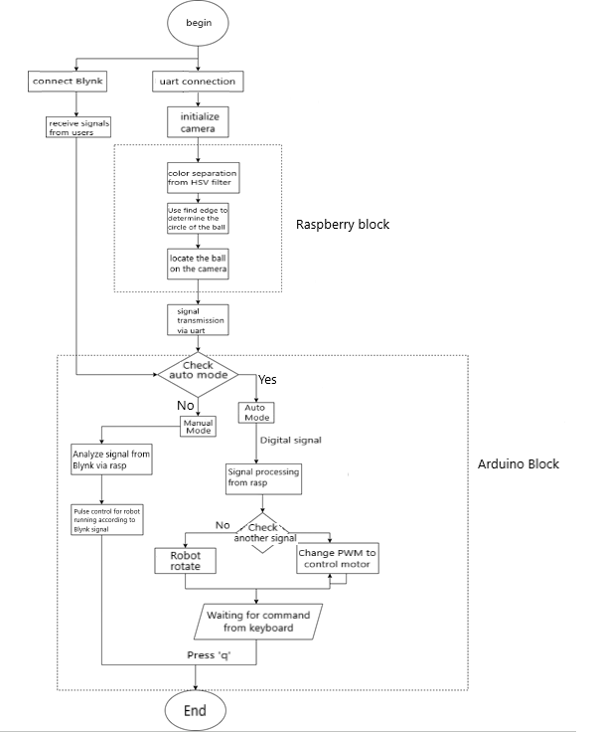
III: Design and Construction
CONTENTS
Algorithm flowchart

Slide 28
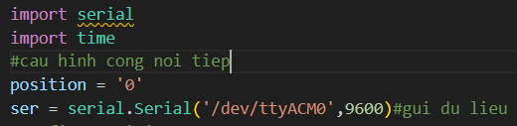
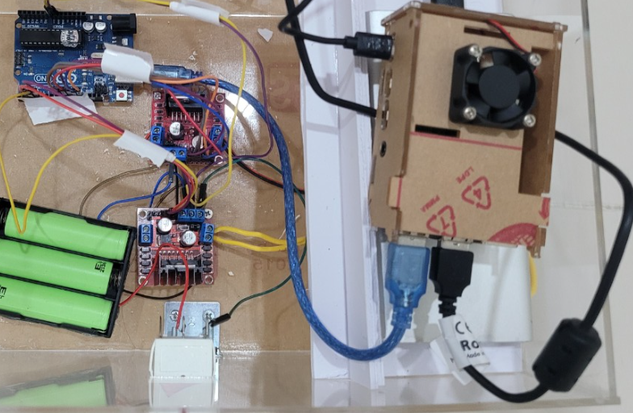
III: Design and Construction
CONTENTS
Passing data from Python to Arduino
- serial.Serial(): initialize the function of the Serial class
in the pyserial library
- '/dev/ttyACM0': connect the device's serial port
- 9600: This is the baud rate
Connect Raspberry Pi and Arduino Uno via USB port

Slide 29
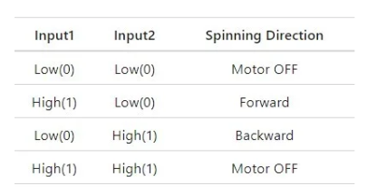
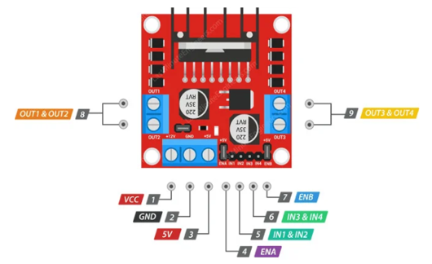
III: Design and Construction
CONTENTS
Communicating L298N DC Motor Control Module with Arduino
Motor control logic board
Pinout of L298N DC Motor Control Module
From here, the Arduino will control the motor module to control the motor as we have programmed.
-Signal 1,2, the Robot will turn left
-Signal 3,4,5 the Robot will go straight
-Signal 6,7 the Robot will turn right.

Slide 30
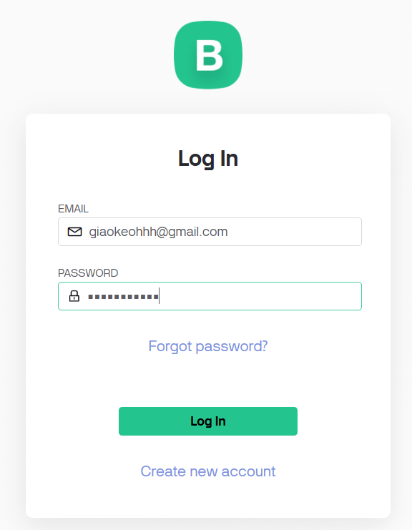
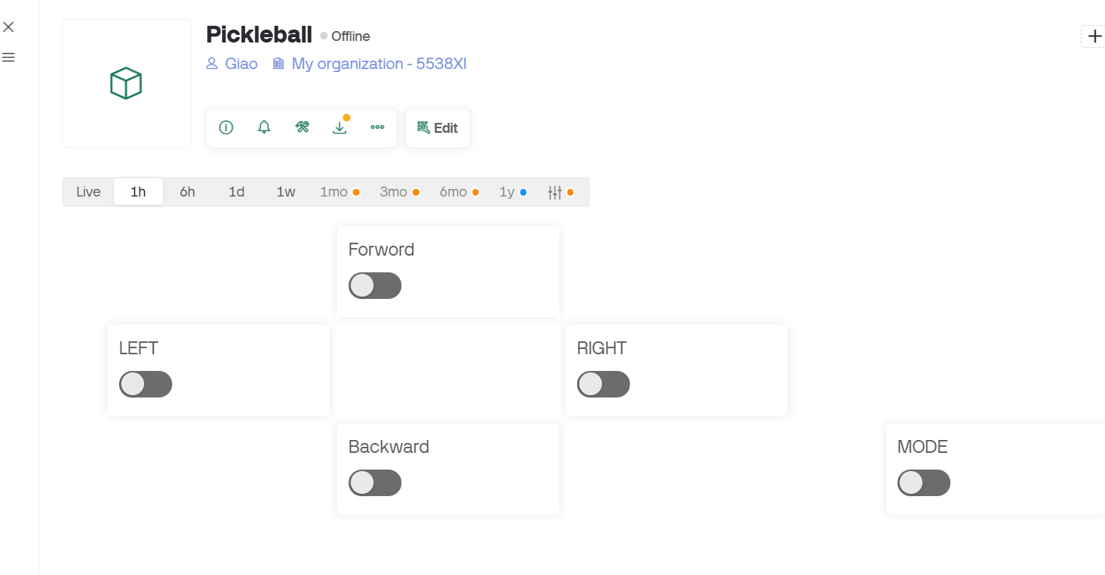
III: Design and Construction
CONTENTS
Control robot via app
Create Web Dashboard
Create a Blynk account

Slide 31
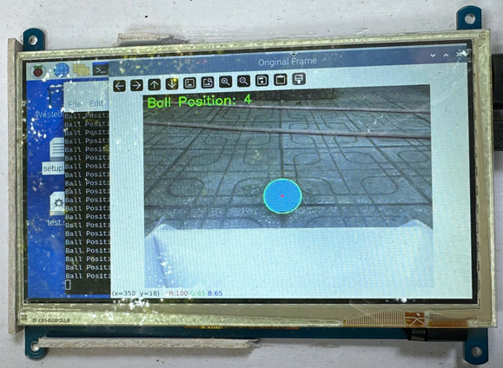
IV: Experiment
CONTENTS
Detect ball position

Slide 32
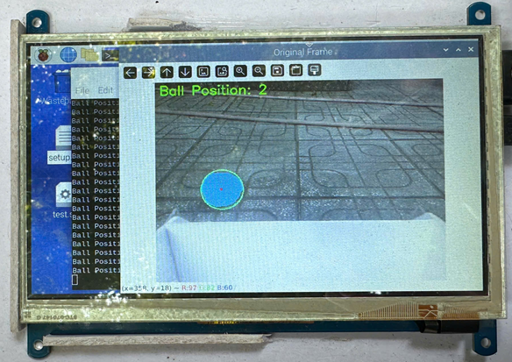
IV: Experiment
CONTENTS
Detect ball position

Slide 33
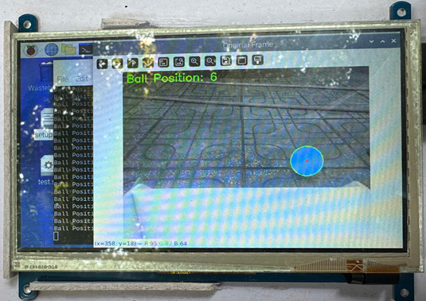
IV: Experiment
CONTENTS
Detect ball position

Slide 34
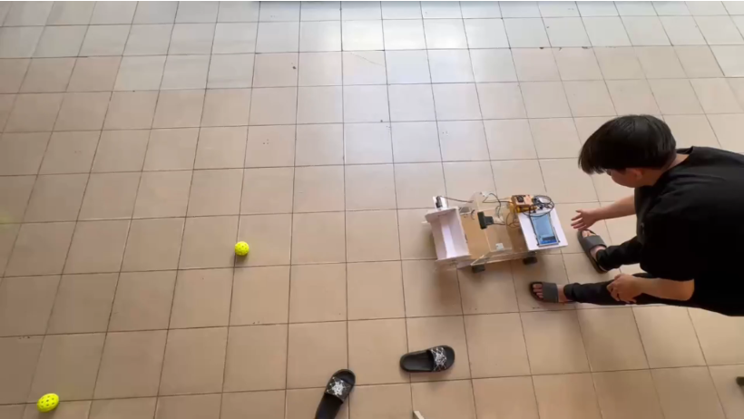
IV: Experiment
CONTENTS
Auto mode

Slide 35
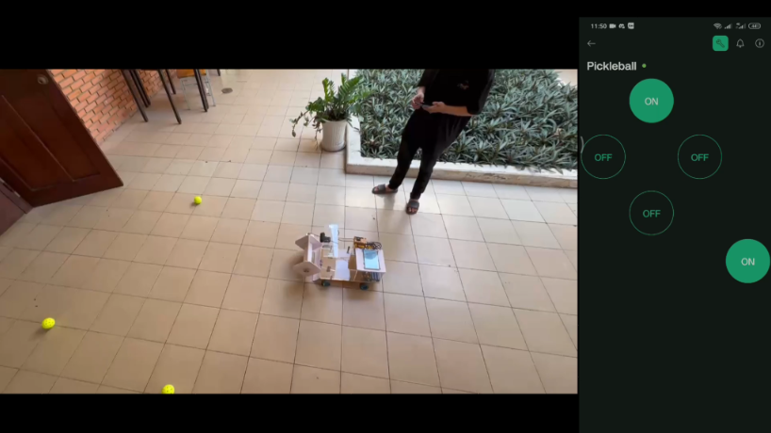
IV: Experiment
CONTENTS
Manual mode

Slide 36
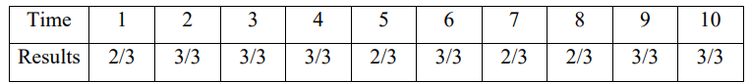
IV: Experiment
CONTENTS
After testing in left, straight, and right positions, the robot can work quite well.
With 10 tests, the robot has the following results:
Conclusion: Testing with the pickleball in all 3 directions,
the robot recovered the ball with a fairly high rate of 87%.

Slide 37
V: Conclusion
CONTENTS
Conclusion
-The model runs exactly as the topic requires
-Image processing correctly identifies the pickleball according to the problem requirements
-Pickleball retrieval is quite accurate with relative speed
-Precise manual mode control
Advantages
-The robot has a relatively moderate size to be able to hold many balls.
-The hardware is made of mica, lightweight cardboard and is cheap
-The processing speed is quite fast and relatively accurate
-Can be controlled via app from phone
Disadvantages
-Lack of calculation experience makes the robot unstable
-Operating time is not long-lasting
-There are also limitations in the camera's vision so sometimes the ball can be next to the side of the car without the car detecting it.
-The robot can collect balls in areas close to the wall, but it still cannot reach the corner areas to collect balls.

Slide 38
V: Conclusion
CONTENTS
Difficulties in implementing the project
-Difficulty in choosing suitable materials and testing the ball collecting mechanism, when assembling the paddle wheel is not firm, leading to deformation or popping out of the paddle wheel while collecting the ball. The paddle wheel speed must be reasonable, if the speed is too high, the ball will not have time to go inside but will be continuously pushed out by the paddle wheel, if the speed is too low, there will not be enough force to push the ball in.
- The ball guide mechanism has problems that can cause the ball to get stuck when the paddle wheel is rotating.
- Some devices are purchased old, so they cannot be used well and it takes time to buy new devices.
- Difficulty in finding reference documents and available project information sources.
When experimenting with moving, there are problems such as not being able to locate the ball position, the vehicle does not move in the desired direction in the code, there are many errors in programming and battery capacity problems, so the engine cannot operate strongly enough and long enough.

Slide 39
V: Conclusion
CONTENTS
Development direction
-Find ways to optimize accuracy, ball detection and ball picking speed.
-Create a new ball collecting mechanism that can collect balls lying in the corner of walls or corners of strange objects.
-Can withstand impact when hit by a ball.
-Make a phone application that connects to the robot to monitor parameters such as battery, number of balls in the basket, and alert when there is a problem.
-Design to increase the size of the basket to hold more balls.
-Add ambient sensors to continuously avoid obstacles or when approaching walls.

Slide 40
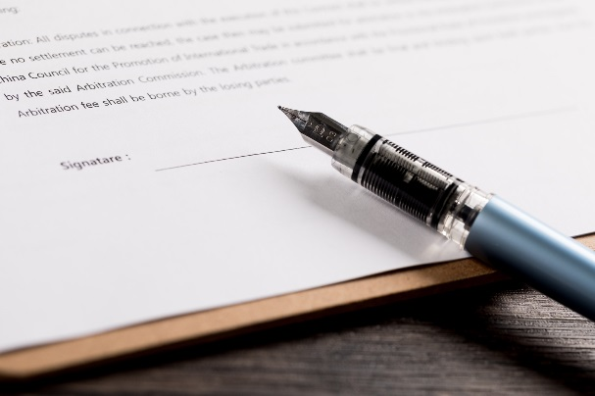
Thank you

